Slide 1
Master Thesis: Evaluation of ABS in Modeling Real World Safety-Critical Systems
Chunyuan Yu
Superviser:
Eduard Kamburjan, M.Sc.

Slide 2
Overview
· Motivation
- Nowadays, modeling languages are used in the area of system modeling.
- Abstract Behaviour Specification (ABS) Language is well suited to model systems that are concurrent, distributed, and highly reusable.
· Goal of the Thesis
- To evaluate ABS as a modeling language for real world safety-critical systems.

Slide 3
Introduction I
· Case Study I. Hybrid ERTMS/ETCS Level 3 Standard (ABZ 2018)
- It is based on the European Rail Traffic Management System (ERTMS).
- It aims to provide an integrated European railway system, in order to improve the capacity, safety and reliability.
- Subparts of trackside detection sections called are used to stamp the train position information. VSS (Virtual Sub-Sections)

Slide 4
Introduction II
· Case Study II. Hemodialysis (HD) Machine (ABZ 2016)
- The HD machine has the functions to transport the patients’ blood from
and back to the patients’ body with getting it filtered.
- Both the general safety condition and software monitor function should be considered when building the whole HD system.

Slide 5
ABS Language
· ABS language is a newly developed modeling language at an abstract level.
· It solves the problem about the architecture of software between the design and implementation part as a modeling language.
· ABS is object-oriented and has many features.
· Distributed, Safe Concurrency, Actor-based…

Slide 6
Future
· In ABS, communication and synchronization are decoupled.
· Future type is used to achieve this goal in asynchronous method calls.
· Futures act as references for return values.
- e.g. Fut<Int> f is a future variable with a return value of an integer.
· The current process is suspended until the asynchronous method call is done, then the future is allowed to retrieve the method and get the result.

Slide 7
Example of Future
Unit call() {
Fut<Unit> fut = thread1!run_A(thread2,i) ;
fut.get ; }
Unit run_A(Thread t, Int i) {
println("A" + intToString(i)) ;
Fut<Unit> f = t!run_B(i) ;
f.get ; }
Unit run_B(Int i) {
println("B" + intToString(i)) ; }

Slide 8
Case Study I. The Train Model
· Based on the Hybrid ERTMS/ETCS Level 3 Specification, three kinds of trains are described in this train model.
· TIMS-equipped ERTMS train (Integer train)
- It precisely occupies the exact VSS it is in.
· ERTMS train not fitted with TIMS
- It occupies the sections in the rear of the track, until the end of the trackside detection section.
· Non-ERTMS train
- It occupies the whole trackside detection section as soon as it appears on the track.

Slide 9
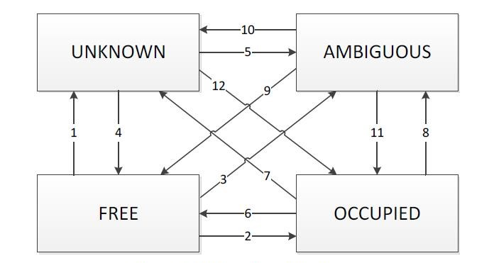
Status Transition among VSS

Slide 10
VSS
· VSS (Virtual Sub-Sections).
· In order to track the train and confirm the location in real-time, the status of each VSS should be measured.
· Two methods are used for the leave and arrive action of the train:
- Unit leave(Int trainNo, VSS vss, Int leavePoint, Int arrivePoint) ;
- Unit arrive(Int trainNo, Int arrivePoint) ;
· Considering the status of TTD,
- If all the VSS of the current TTD are free, then the status of TTD is free.
- If at least one of the VSS of the current TTD is not free, then the status of TTD should be occupied.

Slide 11
RBC
· RBC is a trackside system, which is used to stores the information of the status of each VSS, and help propagate information between the train and the VSS.
· In class RBCImpl, the status of each VSS is marked using a map from the VSS and the current status it has.
· RBC tells every train its End of Authority (EoA) to indicate the furthest VSS a train can arrive.

Slide 12
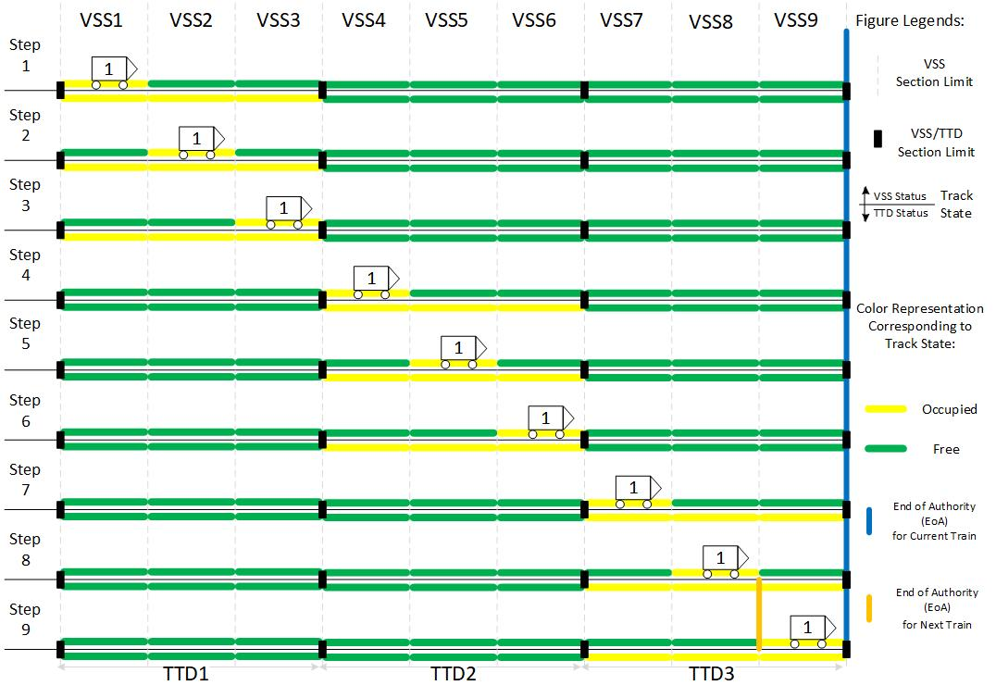
TIMS-equipped ERTMS Train

Slide 13
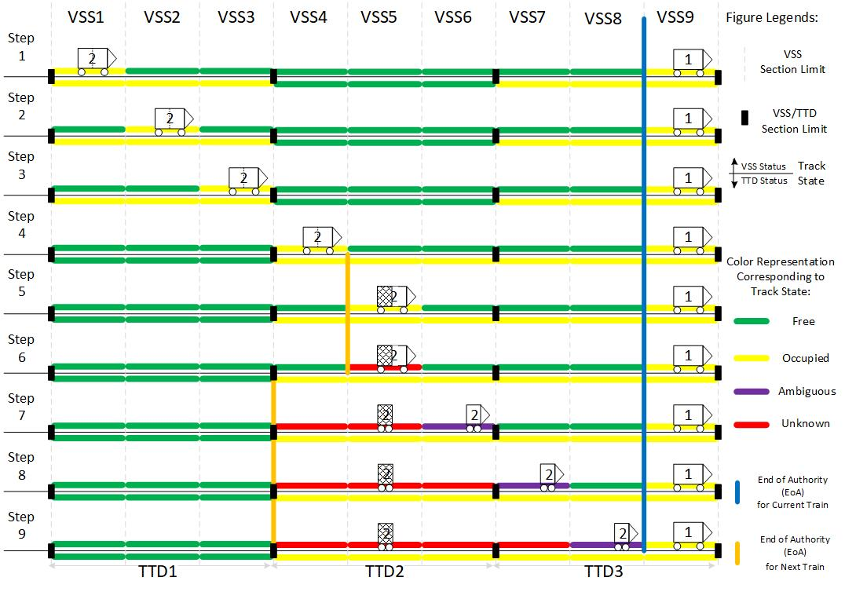
ERTMS Train not fitted with TIMS

Slide 14
Analysis and Evaluation
· Deadlock Analysis
- Deadlock Analysis (SACO) toolkit
· Dynamic Analysis
- Simulator(Erlang)
· Evaluation

Slide 15
To Be Done Next
· Case Study II. The Hemodialysis(HD) Model
- In this HD model, the machine should be able to choose the exact type of therapy, do the therapy preparation including making sure of all the materials and parameters, do the therapy initiation and ending.
- Both the general safety condition and software monitor function should be considered when building the whole HD system.

Slide 16
Questions?
Thank you for
your attention!

